Slide 1
What Designers Need to Know about Accessibility (A11y)
Jon Gunderson, Ph.D.
Disability Resources and Education Services University Of Illinois – Urbana/Champaign
2018 ConveyUX Conference, Seattle, WA

Slide 2
Designers Are Critical for A11y
Remediation (Dominate)
Build the product add accessibility at the end or as users identify issues.
Automated testing (Very Popular)
Automated tools during the development process use to identify accessibility issues to fix.
Some services advertise they don’t need to do anything theirservice will make your product accessible.
Design (Rare)
Understanding the needs and interaction of people with disabilities (PWD) using assistive technologies or OS accessibility features.

Slide 3
First Steps in A11y Design
Accessibility basics
Role
Name
Description
ARIA Landmarks and HTML Headings
Keyboard interaction model
Keyboard focus styling

Slide 4
Role, Name and Description
Role
Type of user interface element
Name
Label for the user interface element (e.g. purpose or action)
Description
Additional information about a user interface element (e.g. instructions or context for name)

Slide 5
Example Roles
Role | HTML Elements
heading | H1, h2, h3, h4, h5 and h6
list | ul, ol and dl
listitem | li
image | img and figure
link | a and area
textbox | Input[type=text]
button | button, input[type=button], input[type=submit], input[type=reset]

Slide 6
Name and Description
Name
Text content
label element
aria-label or aria-labelledby attribute
title attribute
Description
aria-describedby attribute
title attribute

Slide 7
Good Examples
Screen readers first read role, then the name and then, if defined, the description.
Markup | Screen Reader | What’s Happening
<a href=“..”>ConveyUX Conference</a> | link ConveyUX conference | Role is “link” Name from text content
<button title=“Like Sound Transit’s Page on Facebook”></button> | button like sound transit’s page on facebook | Role is “button” Name from title attribute
< a href=“..” title=” Tacoma Link light rail”>Learn More</a> | link learn more Tacoma link light rail | Role is ”link” Name from text Description from title attribute

Slide 8
Bad Examples
Markup | Screen Reader (SR) | Accessibility Issue
<button title=“Like Sound Transit’s Page on Facebook” aria-label=“=“Like Sound Transit’s Page on Facebook”></button> | button like sound transit’s page on facebook button like sound transit’s page on facebook | Problem is that SR repeats the name of the button, this is redundant and confusing
<a href=“..” title=“Link to Twitter”></a> | link link to twitter | Problem is that SR says “link” twice, this is redundant and confusing
<a href=“..” aria-label=“Update User Profile” title=“Update User Profile”>jongund</a> | link update user profile update user profile | Problem for SR since ”jongund” is not part of name and the defined name is read twice by the SR Problem for voice recognition users because visible label does not match the accessible name

Slide 9
Landmarks and Headings
Landmarks
Identify functional groupings of page content
Screen readers can navigate and list landmarks
ARIA Authoring Practices for Landmarks (example)
Headings
Labeling landmarks (H1 and H2)
Labeling the sections and sub-sections within a document (H1-H6)
Screen readers can navigate and list landmarks

Slide 10
Landmarks
Landmark | Frequency of Usage | Usage
banner | None or one | The common content typically found at the top of each page in a website.
complementary | As many as needed, often none | Identifies unique page content not part of the main landmark.
contentinfo | None or one | The common content typically found at the bottom of each page in a website.
main | Typically one | Identify the main content area or areas of a web page or application
navigation | As many as needed | Identify website navigational links
region | As many as needed | region role is only considered a landmark when it has an accessible name. Used to identify sub-sections of other landmarks
search | Typically one or none | Identify website search features

Slide 11
Screen Reader Commands
OSX Voice Over
Command+F5: Starts or stops Voice Over
Cotrol+Option+Command+H: Next heading
Control+Option+U: Accessibility Rotor includes Landmark and Heading Lists
Windows NVDA
D/Shift+D: Next/previous Landmark
H/Shift+H: Next/previous Heading
Insert+F7: List of elements including Headings and Landmarks
Windows JAWS
Q/R: Next/previous Landmark
Insert+Control+R: List of Landmarks (e.g. regions)
H/Shift+H: Next/previous Heading
Insert+F6: List of Headings

Slide 12
Landmark and Heading Examples
Accessibility Bookmarklets for visualizing Landmarks and Headings

Slide 13
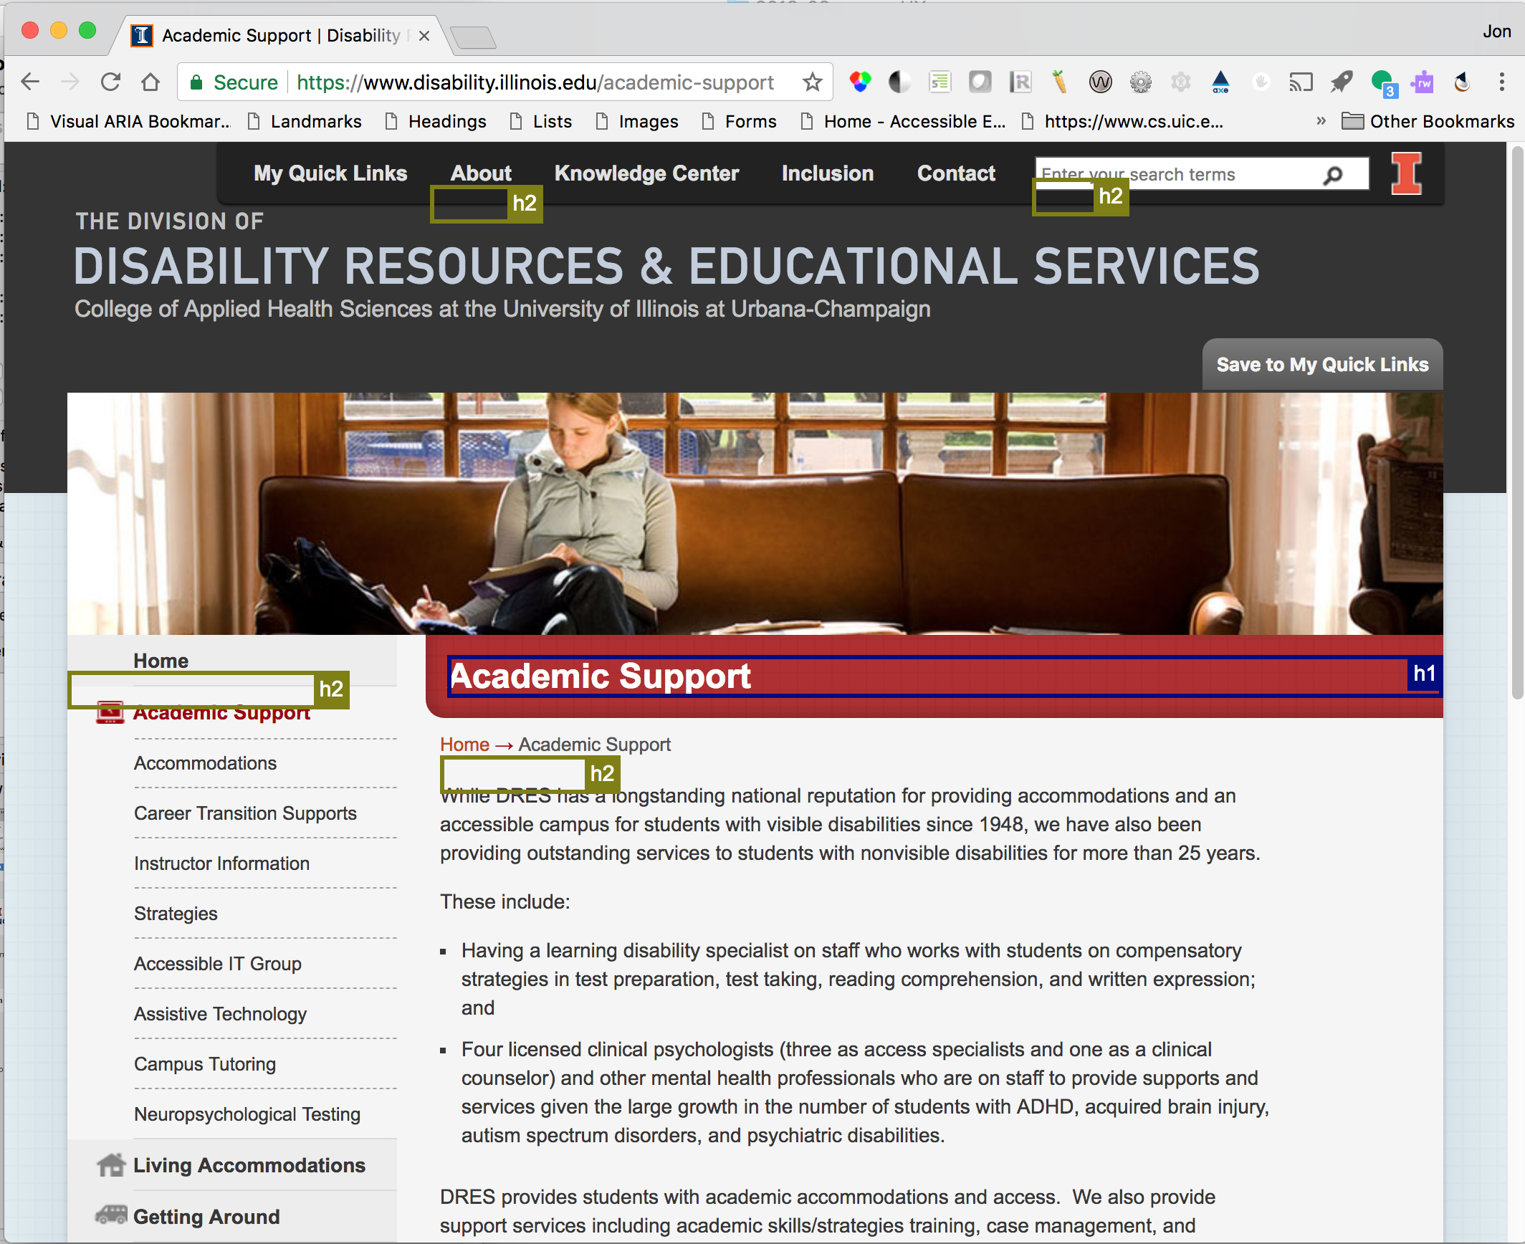
Good Use of Headings

Slide 14
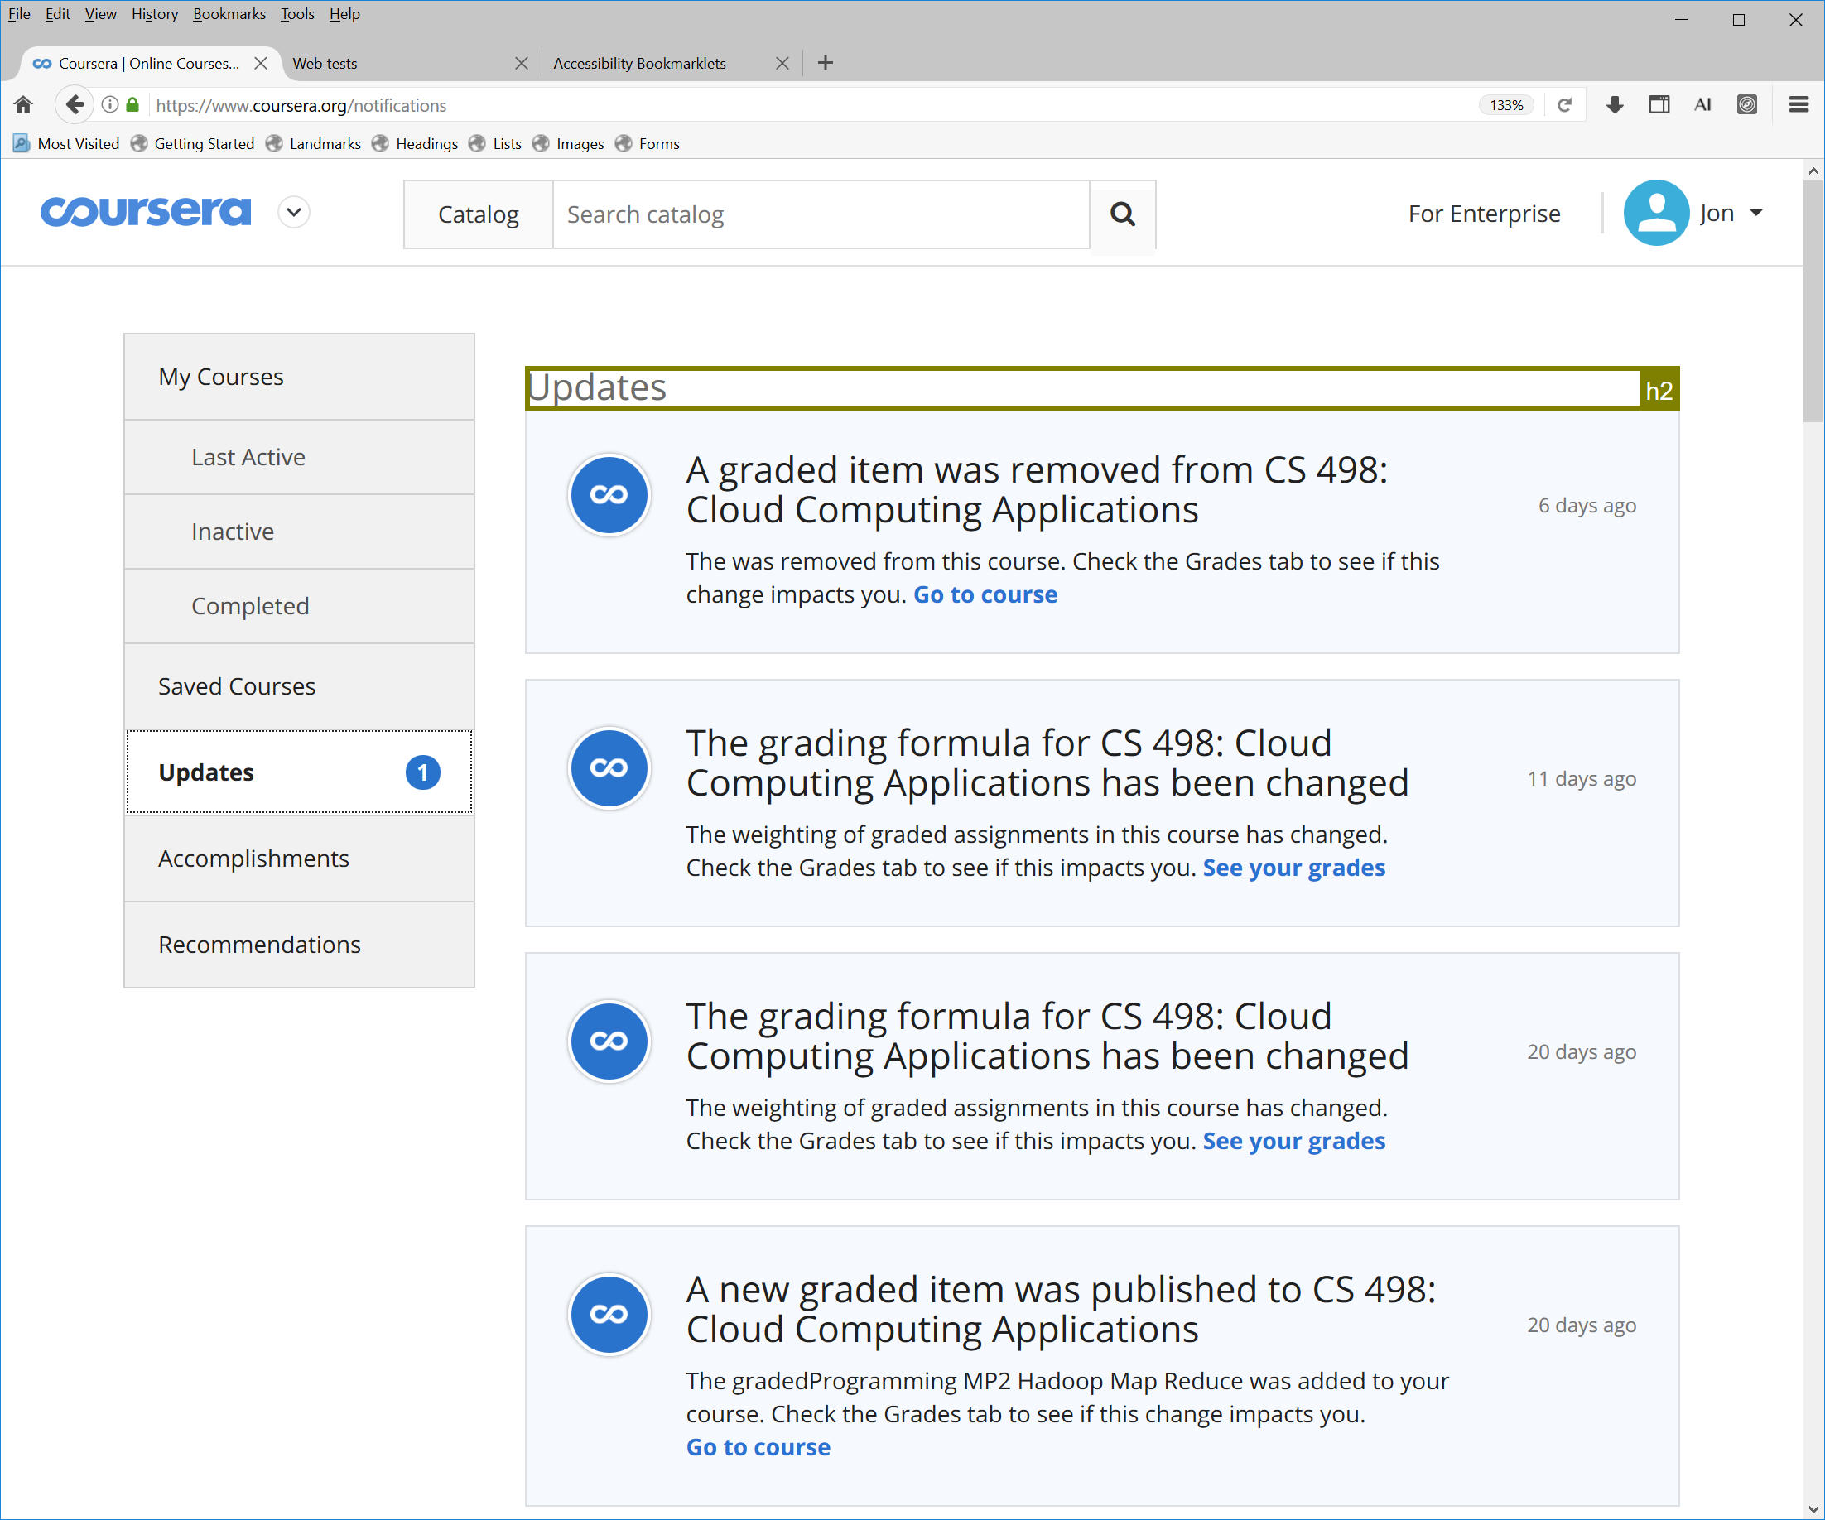
Under Use of Heading Structure

Slide 15
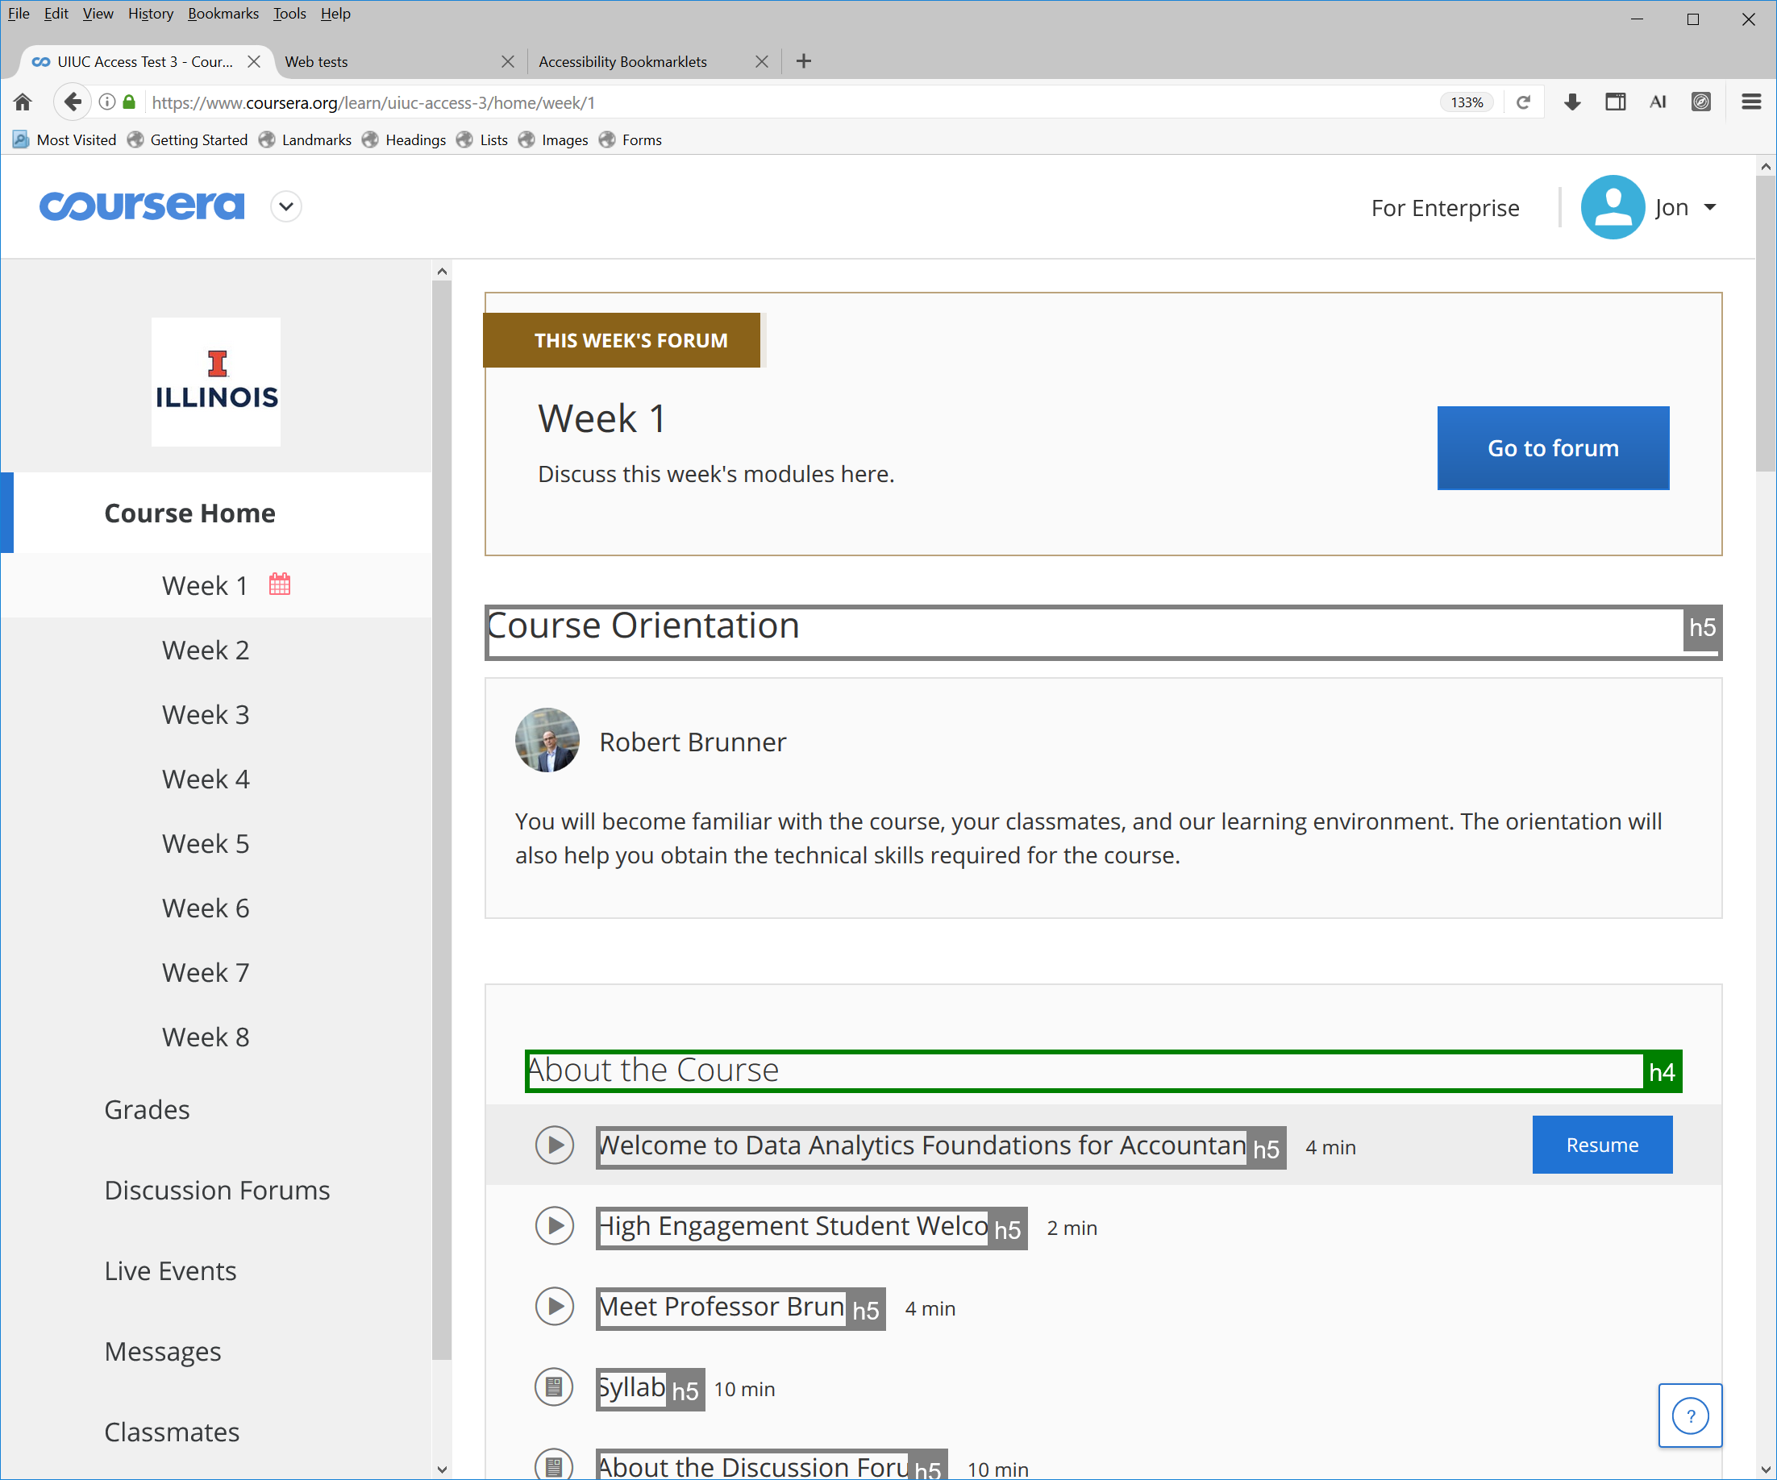
Over Use Headings

Slide 16
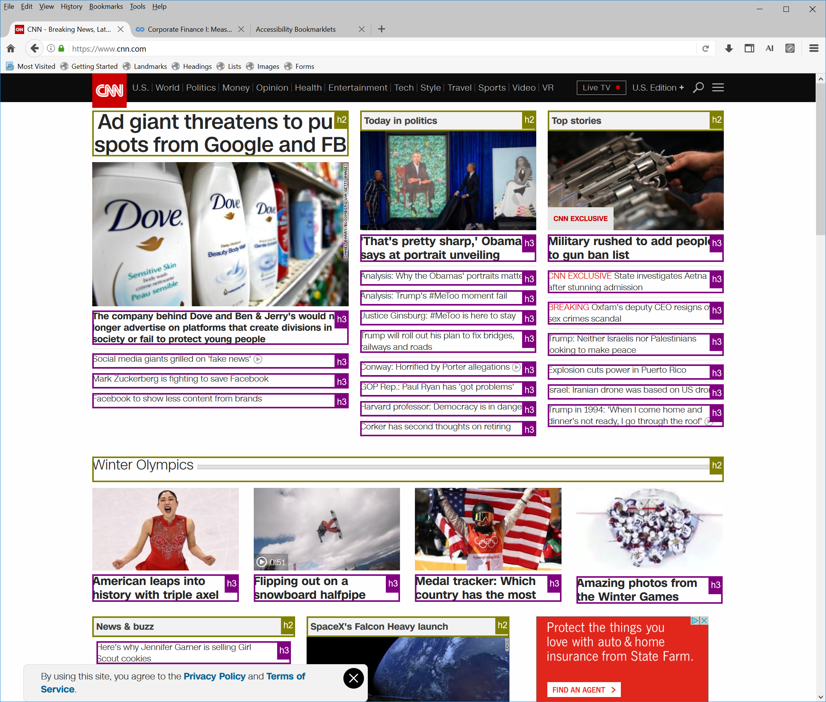
Over Use of Headings

Slide 17
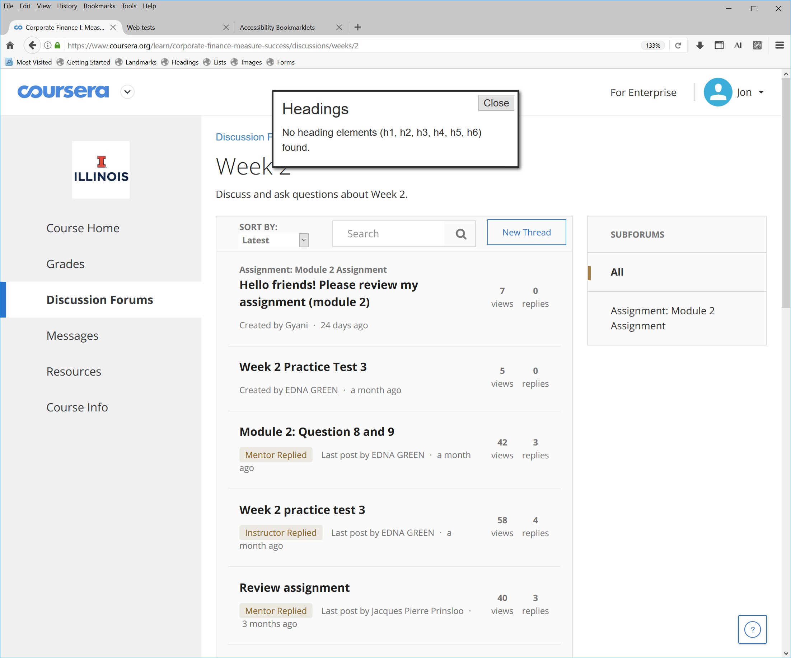
No Use of Headings

Slide 18
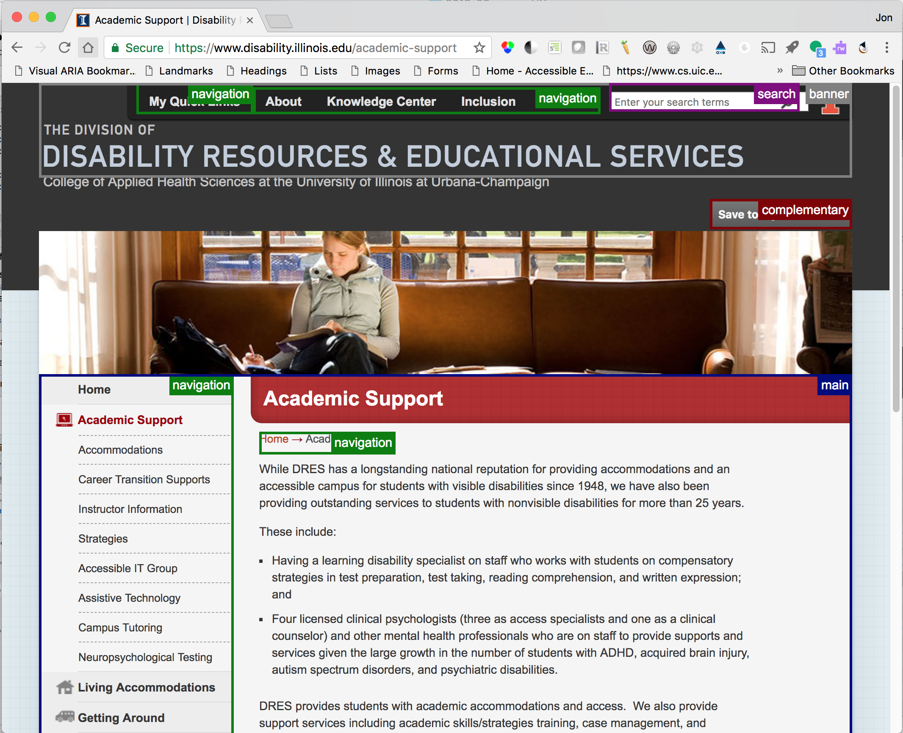
Good Use Of Landmarks

Slide 19
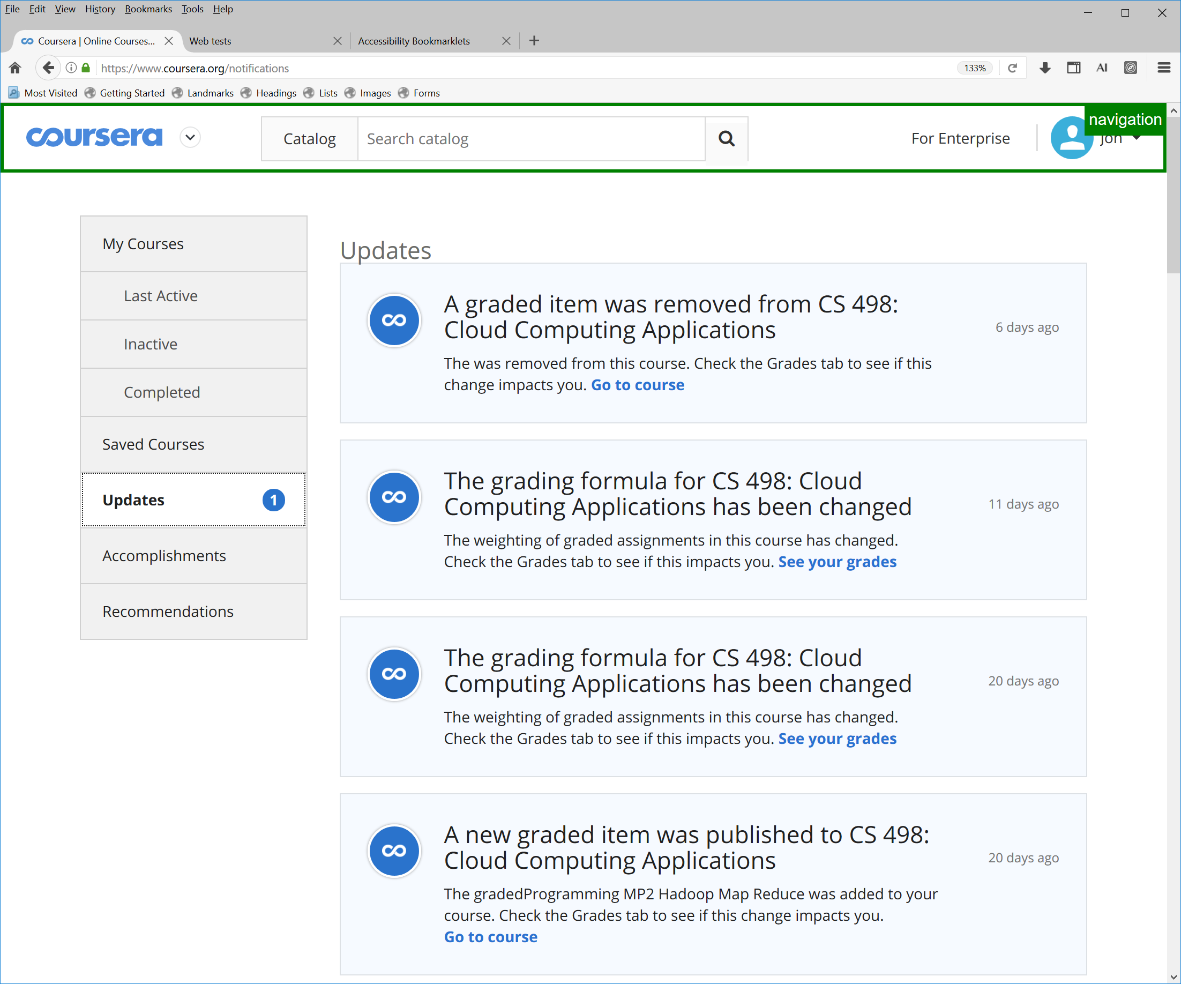
Under Use of landmarks

Slide 20
Keyboard Interaction Model
All functionalities must be accessible through keyboard alone
Interactive elements must have keyboard support
Basic tab navigation is often inefficient or incomplete
ARIA widget roles describe advanced keyboard interaction
ARIA Authoring Practices provide design patterns for roles and keyboard interaction

Slide 21
Menu Role Example
ARIA Roles describe keyboard interaction, not user interface design features
Tab key moves focus to the selected menu item
When menu has focus, tab key moves focus out of the menu (e.g not to menu items)
Cursor keys to move between items in a menu
Left and up key previous item
Right and down to next item
Home to move to first item
End to move to last item
ARIA Menu Button Design Pattern and Examples

Slide 22
Keyboard Focus Styling
The first accessibility feature I check a web page
Many people interpret WCAG requirements to only “not interfere” with default focus styling of browsers
Reset stylesheets often override and disable default focus styling of browsers
Designers must start actively style keyboard focus as part of the design to make it salient to all users

Slide 23
Keyboard Focus Example
Focus should always be visible (e.g. no off-screen focusable elements)
Focus should include a border for links and form controls
Focus styling must meet color contrast requirements of WCAG
Focus should be easy to see as you navigation with the TAB key
Links in the main content should be underlined (e.g. important for people with low vision)
Inaccessible test page
Accessible test page

Slide 24
Accessibility Can As Your Friend
3.2.3 Consistent Navigation: Navigational mechanisms that are repeated on multiple Web pages within a set of Web pages occur in the same relative order each time they are repeated, unless a change is initiated by the user. (Level AA)
3.2.4 Consistent Identification: Components that have the same functionality within a set of Web pages are identified consistently. (Level AA)

Slide 25
W3C Resources
Web Content Accessibility Guidelines 2.0
Accessible Rich Internet Application (ARIA) 1.1
ARIA Authoring Practices
Using ARIA
HTML5 Specification

Slide 26
Screen Reader Resources
OSX Voice (Safari and Chrome)
Penn State: Voice Over for OS X
Apple Voice Over Commands
Windows NVDA (Open Source)
Penn State: NVDA Keyboard Commands
Webaim: NVDA Keyboard Commands
NVDA: Web Browse Keyboard Commands
Windows Jaws
Penn State: JAWS commands for web
WebAIM: JAWS commands for web
Freedom Scientific: JAWS commands for web

Slide 27
Open Source Tools
The following tools support rules for accessible design requirements outlined in this presentation.
Functional Accessibility Evaluator
AInspector Sidebar for Firefox (ESR 52 Version)
Accessibility Bookmarklets

Slide 28
Additional Training and Resources
Training from Illinois
Information Accessibility Design and Policy Certificate
Accessibility Badges
Other Resources
W3C Web Accessibility Initiative
WebAIM
Knowability

Slide 29
Questions AND DISCUSSION?
Contact Jon Gunderson at jongund@illinois.edu

